Slide 1
ONLINE CAR BOOKING
Name : n.Naga sunil reddy
Reg no : 1920111162
Course code :Csa3731
Course name : software testing
Date : 31-01-2023

Slide 2
Project includes:-
Title
Objective
Abstract
Proposed system
Flow chart
Concept map
No of test cases
App and tools installation
Appium server
Implementing testing
Testcase outcome
Conclusion

Slide 3
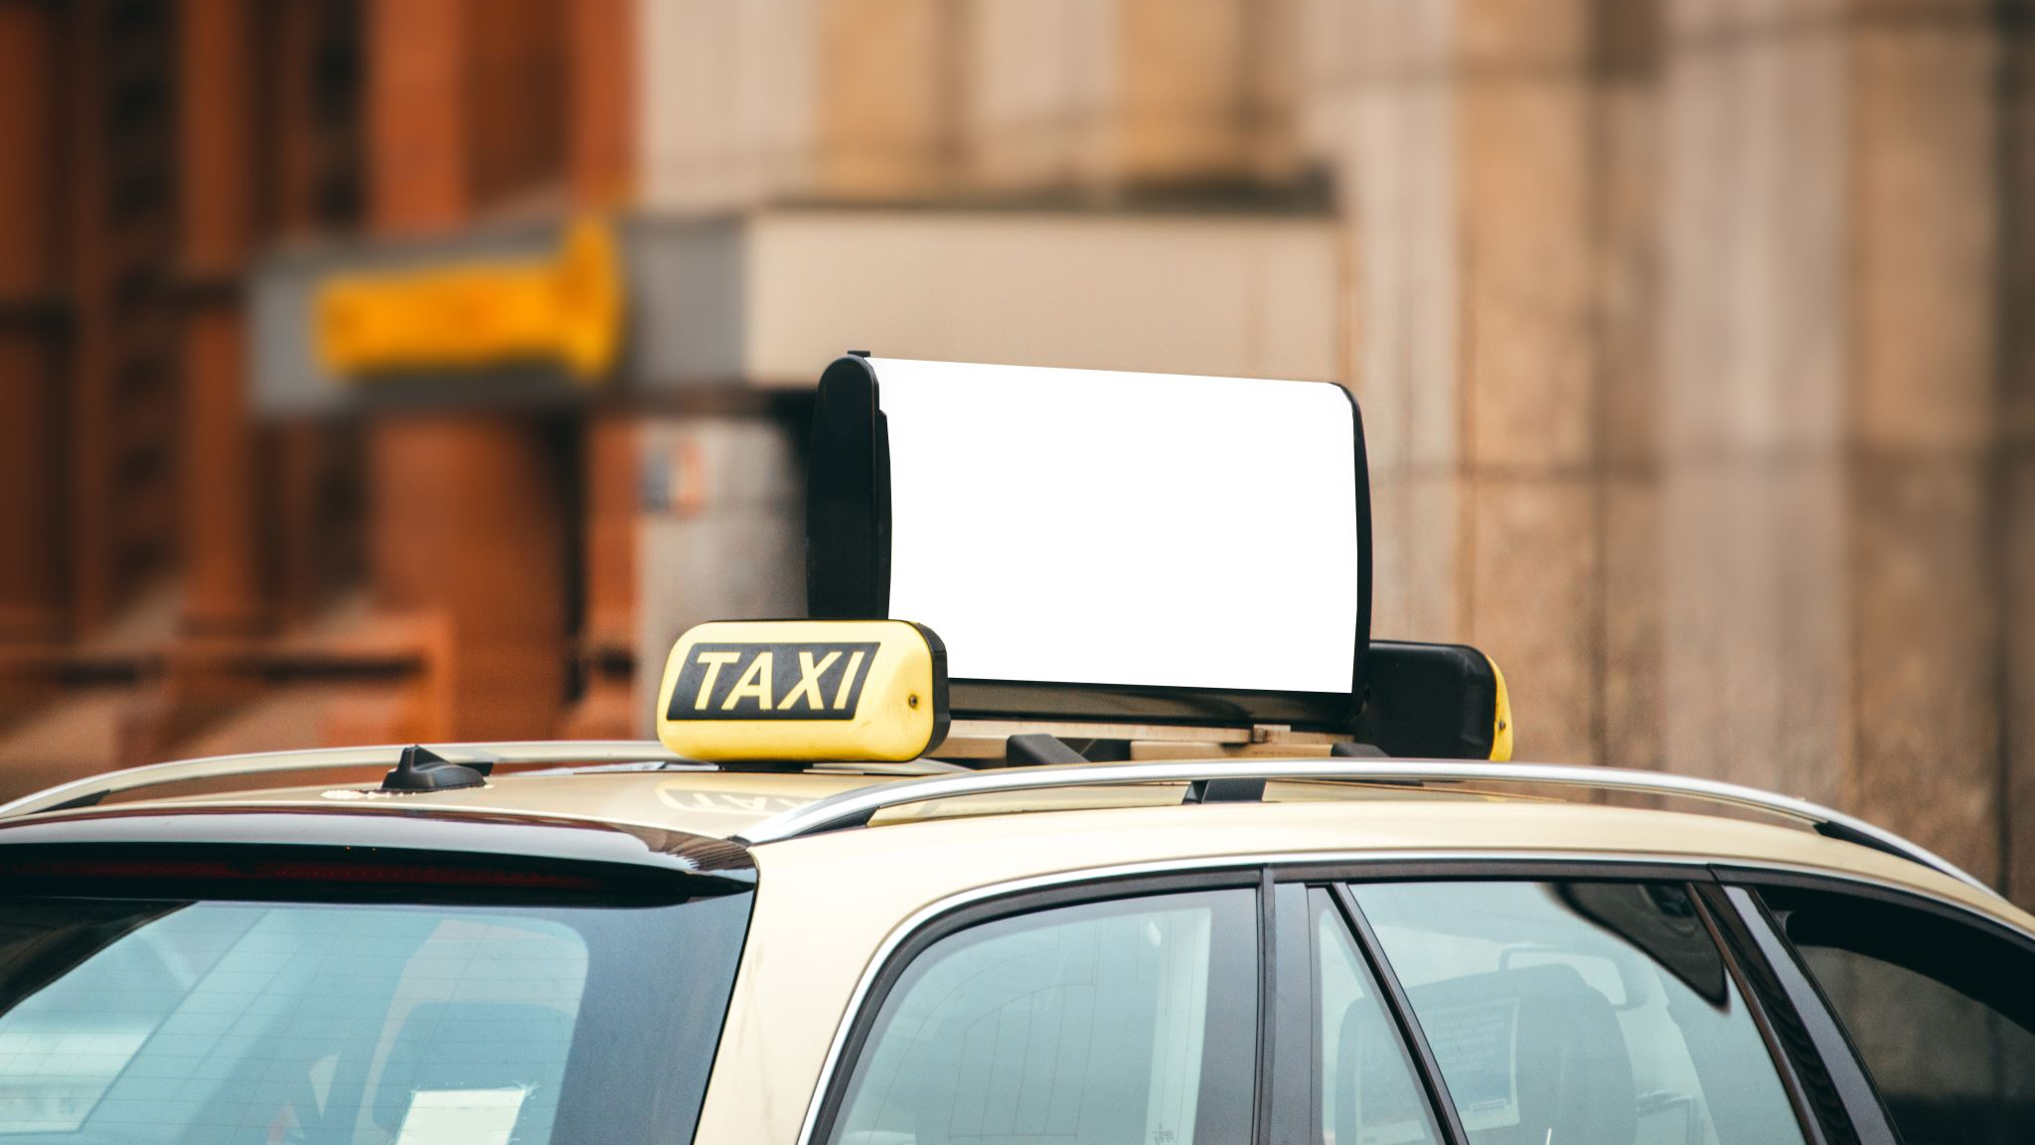
OBJECTIVES:
The goal of an online taxi booking system is to bring riders and drivers together on one platform. The online cab booking system makes traveling easier in this digital age by allowing you to move from one location to another with a single tap

Slide 4

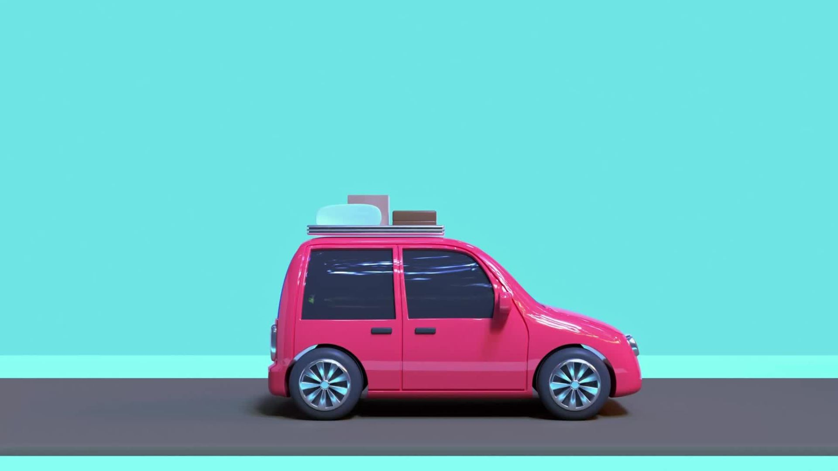
ABSTRACT:
Our Aim is to design and create a data management System for a car rental company.
This enables admin can rent a vehicle that can be used by a customer
This system increases customer retention and simplify vehicle and staff Management in an efficient way.
This software car Rental System has a very user friendly interface.
Thus the users will feel very easy to work on it.
By using this system admin can manage customer confirm and cancel booking request, customer Testimonials, customer issues.

Slide 5

PROPOSED WORK:
In this system, the User is able to hire a driver by entering the details such as place, dates, days, vehicle type, etc.
The system will list down the drivers based on Experience & ratings best suited for the User.
The Driver can cancel the ride if he is not available.
If the Booking is cancelled by the user, he will get a refund.
Location of the driver is updated continuously during the ride.
Both the users & drivers can access the application by registering themselves on the system.
By signing on to the planned Online Cab Booking project website, consumers would be able to order a cab according to their needs.
It allows customers to book taxis online, modify their reservations, and cancel their reservations at any moment.
Users will be alerted of the driver's location and phone number, allowing them to connect with him.
The consumer is informed about their bookings, driver information, and booking progress on a regular basis.
In the feedback form, the user can also submit suggestions or questions

Slide 6
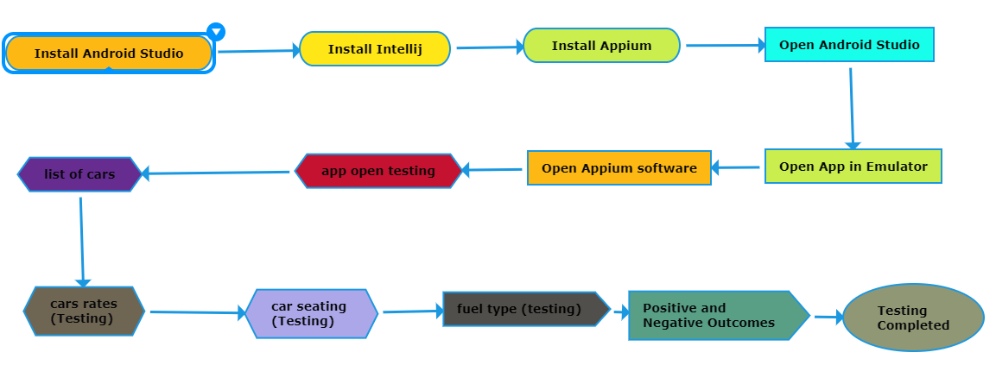
Control flow diagram

Slide 7
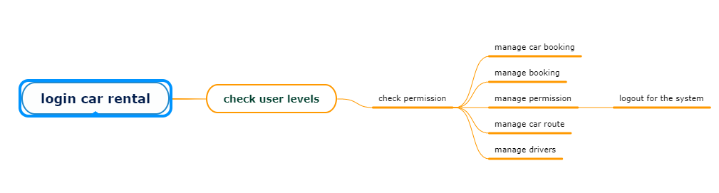
CONCEEPT MAP

Slide 8
NO. OF TEST CASES
Register
Login
Forget password
Bookings
Cars checking
Car type
Customer profile
Payment type
Location
Time

Slide 9



APP USED
APPIUM
INTELLIJ
Android Studio

Slide 10
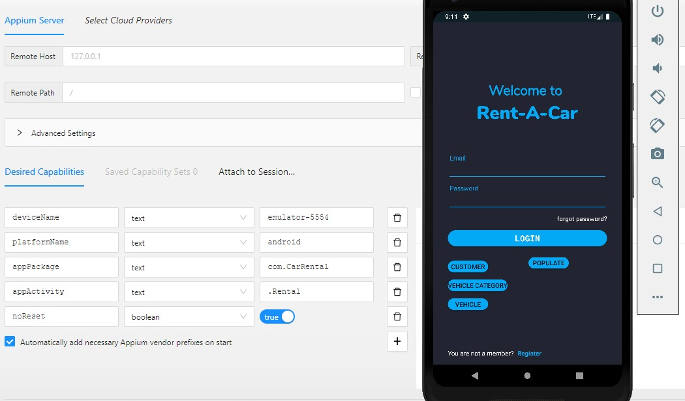
IMPLEMENTATION TESTING SCREENSHOTS-

Slide 11
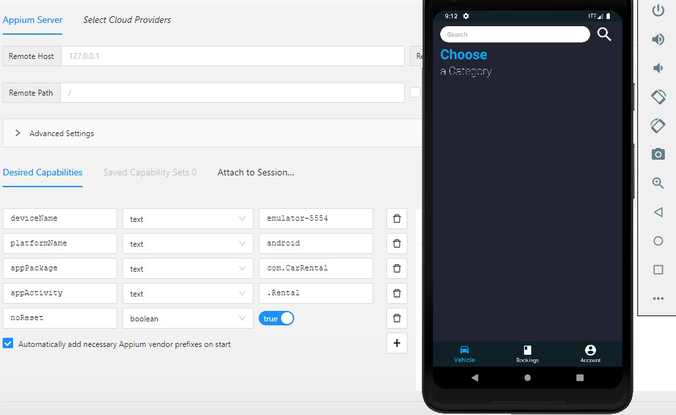

Slide 12
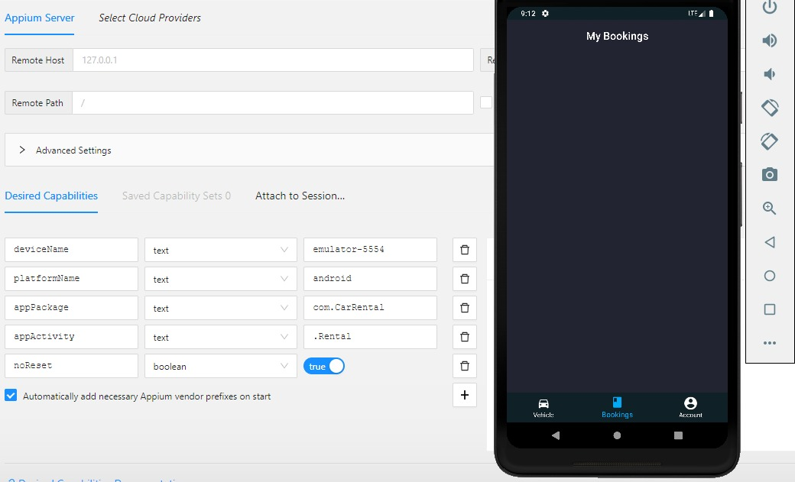

Slide 13
TESTCASES | RESULT
Check if the location is enabled on the mobile/tab, and the pickup location | Positive
Check if the location is disabled on the mobile/tab, then the app | negative
Check by default the booking time is taken as the current time. | Positive
Check if there is an option available to choose/schedule a ride for a later time. | Negative
Check the user should not able to choose a ride time later than one month. | Negative
Check the app shows the suggestion of your previously visited or saved location | Positive
Check the selection of destination works fine. | Positive

Slide 14
TEST CASES | RESULTS
Check that there is an option to search location. | Negative
Check the map gets updated with the location of the driver. | Positive
Check there is an option to call/message the driver. | Positive
Check the cancellation option is available once the booking is confirmed. | Positive
Check the map to show the driver’s location and arrival time. | Positive
Check on cancellation; the current booking is aborted, and the cancellation charge is deducted if applicable | Negative
Check by booking a ride later, and when a cab is booked before the booking user gets the notification. | Positive

Slide 15
CONCLUSION
Customers can use an online Booking system to rent cabs
Customers may use this online system to browse available taxis, view profiles, and book cabs.
Taxi booking is a typical kind of transportation that is offered by a number of different transportation firms in a particular city.
The bulk of people rely on taxi services for their daily transportation needs.
The company must be registered and fulfil all of the transportation department's requirements and security requirements.
This paper demonstrates an effective taxi booking system.
This project included a wide variety of topics, from corporate principles to computer science, and required the completion of a number of courses in order to reach the deadline

Slide 16
THANK YOU

